Slide 1
Grade 8 Program
Avery County Schools
Pam Wilson, Kim Davis, April Jones, Dewayne Krege, David Burleson

Slide 2
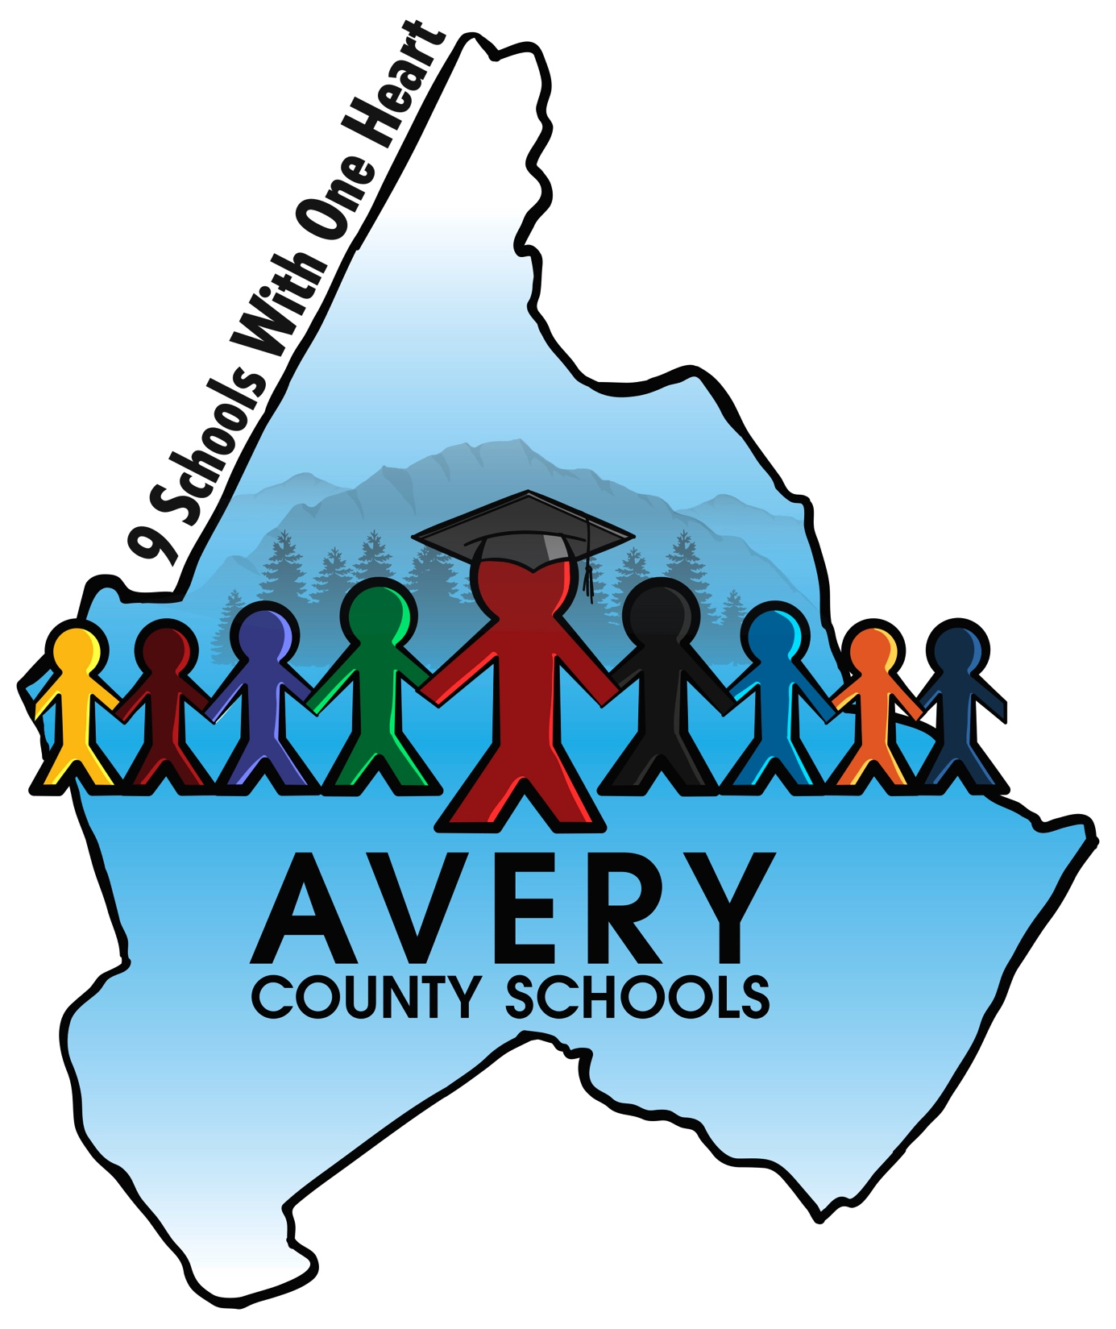
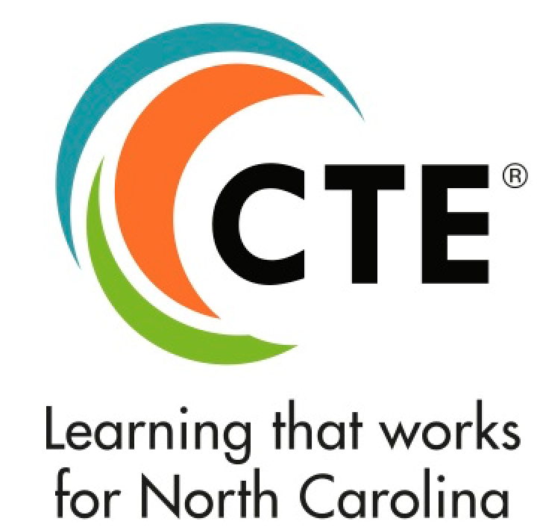
Systemically Educating Young People about Careers Prior to High School
Identified need for our region: Develop an innovative and comprehensive program for 8th graders to: Explore Careers, Plan for Secondary Program of Study, and Plan for Post-Secondary Education to allow them to move toward future opportunities

Slide 3
Grade 8 Outcomes
Students understand finding their career is a process with clear steps and actions
Students understand how interests and aptitudes influence school and career paths
Students understand how high school classes apply to future goals/successes
Students interact with counselors and representatives from business and industry
Students understand workforce needs in our region and state
Students understand skills, educational requirements, and expectations necessary for acquiring initial jobs and developing careers
Students and parents understand the process and are prepared to register for high school

Slide 4
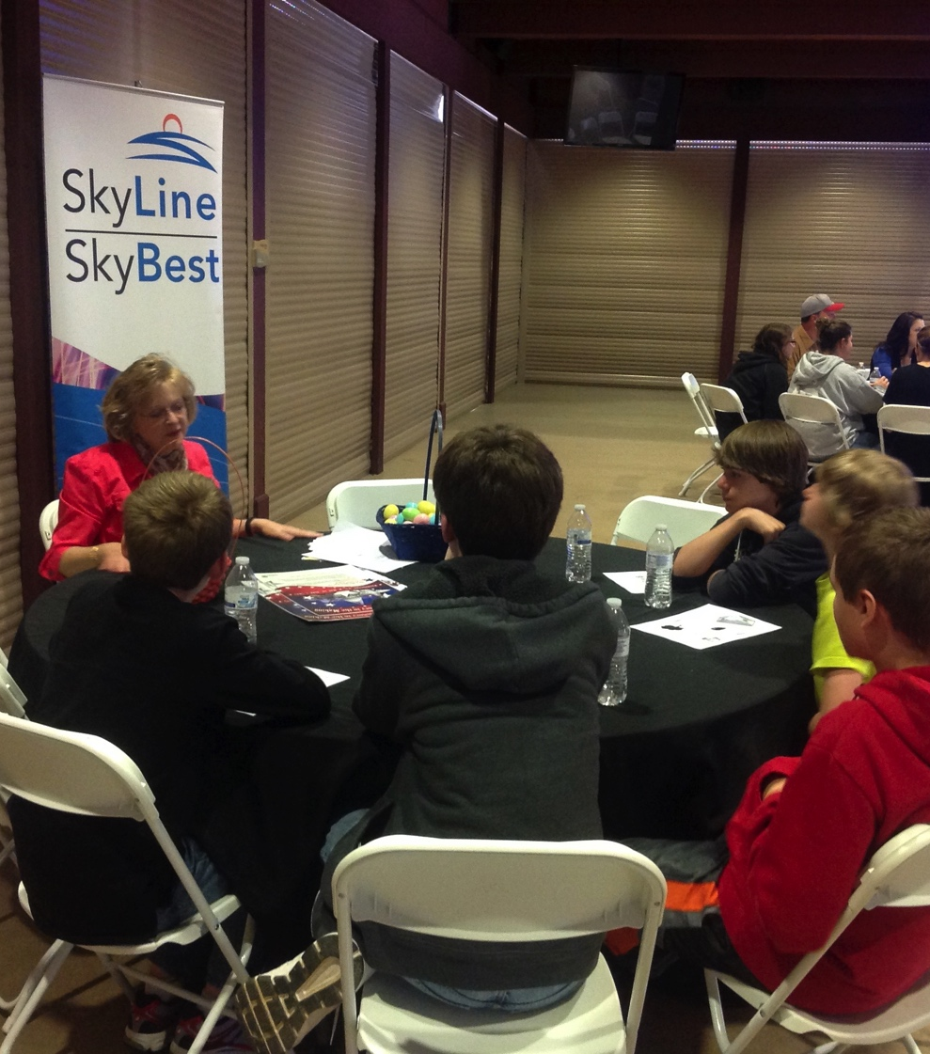
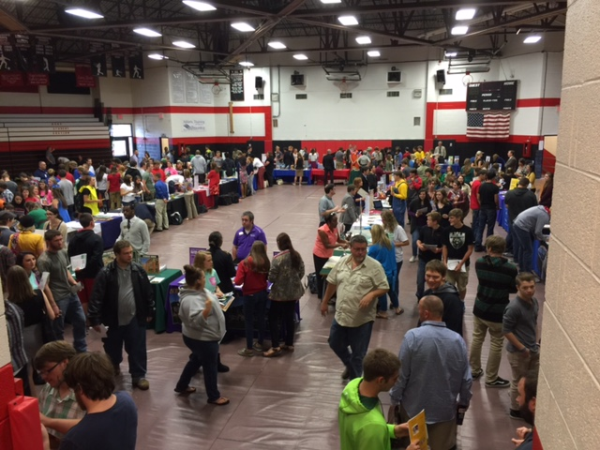
Interaction with Representatives from Business, Industry, and Post-Secondary Education
Roundtable discussions, demonstrations, Career Jeopardy, and Career-Fair activities help students:
Understand workforce needs
Understand skills, educational requirements, and expectations

Slide 5
Finding your career is a process…
Identify Interests/Aptitudes
Learn about Career Technical Education Programs
Understand Academic and Graduation Requirements
Identify Career Pathways and high school career opportunities including:
Job Shadowing
CTSOs
Internships
Begin developing Four Year Plans

Slide 6
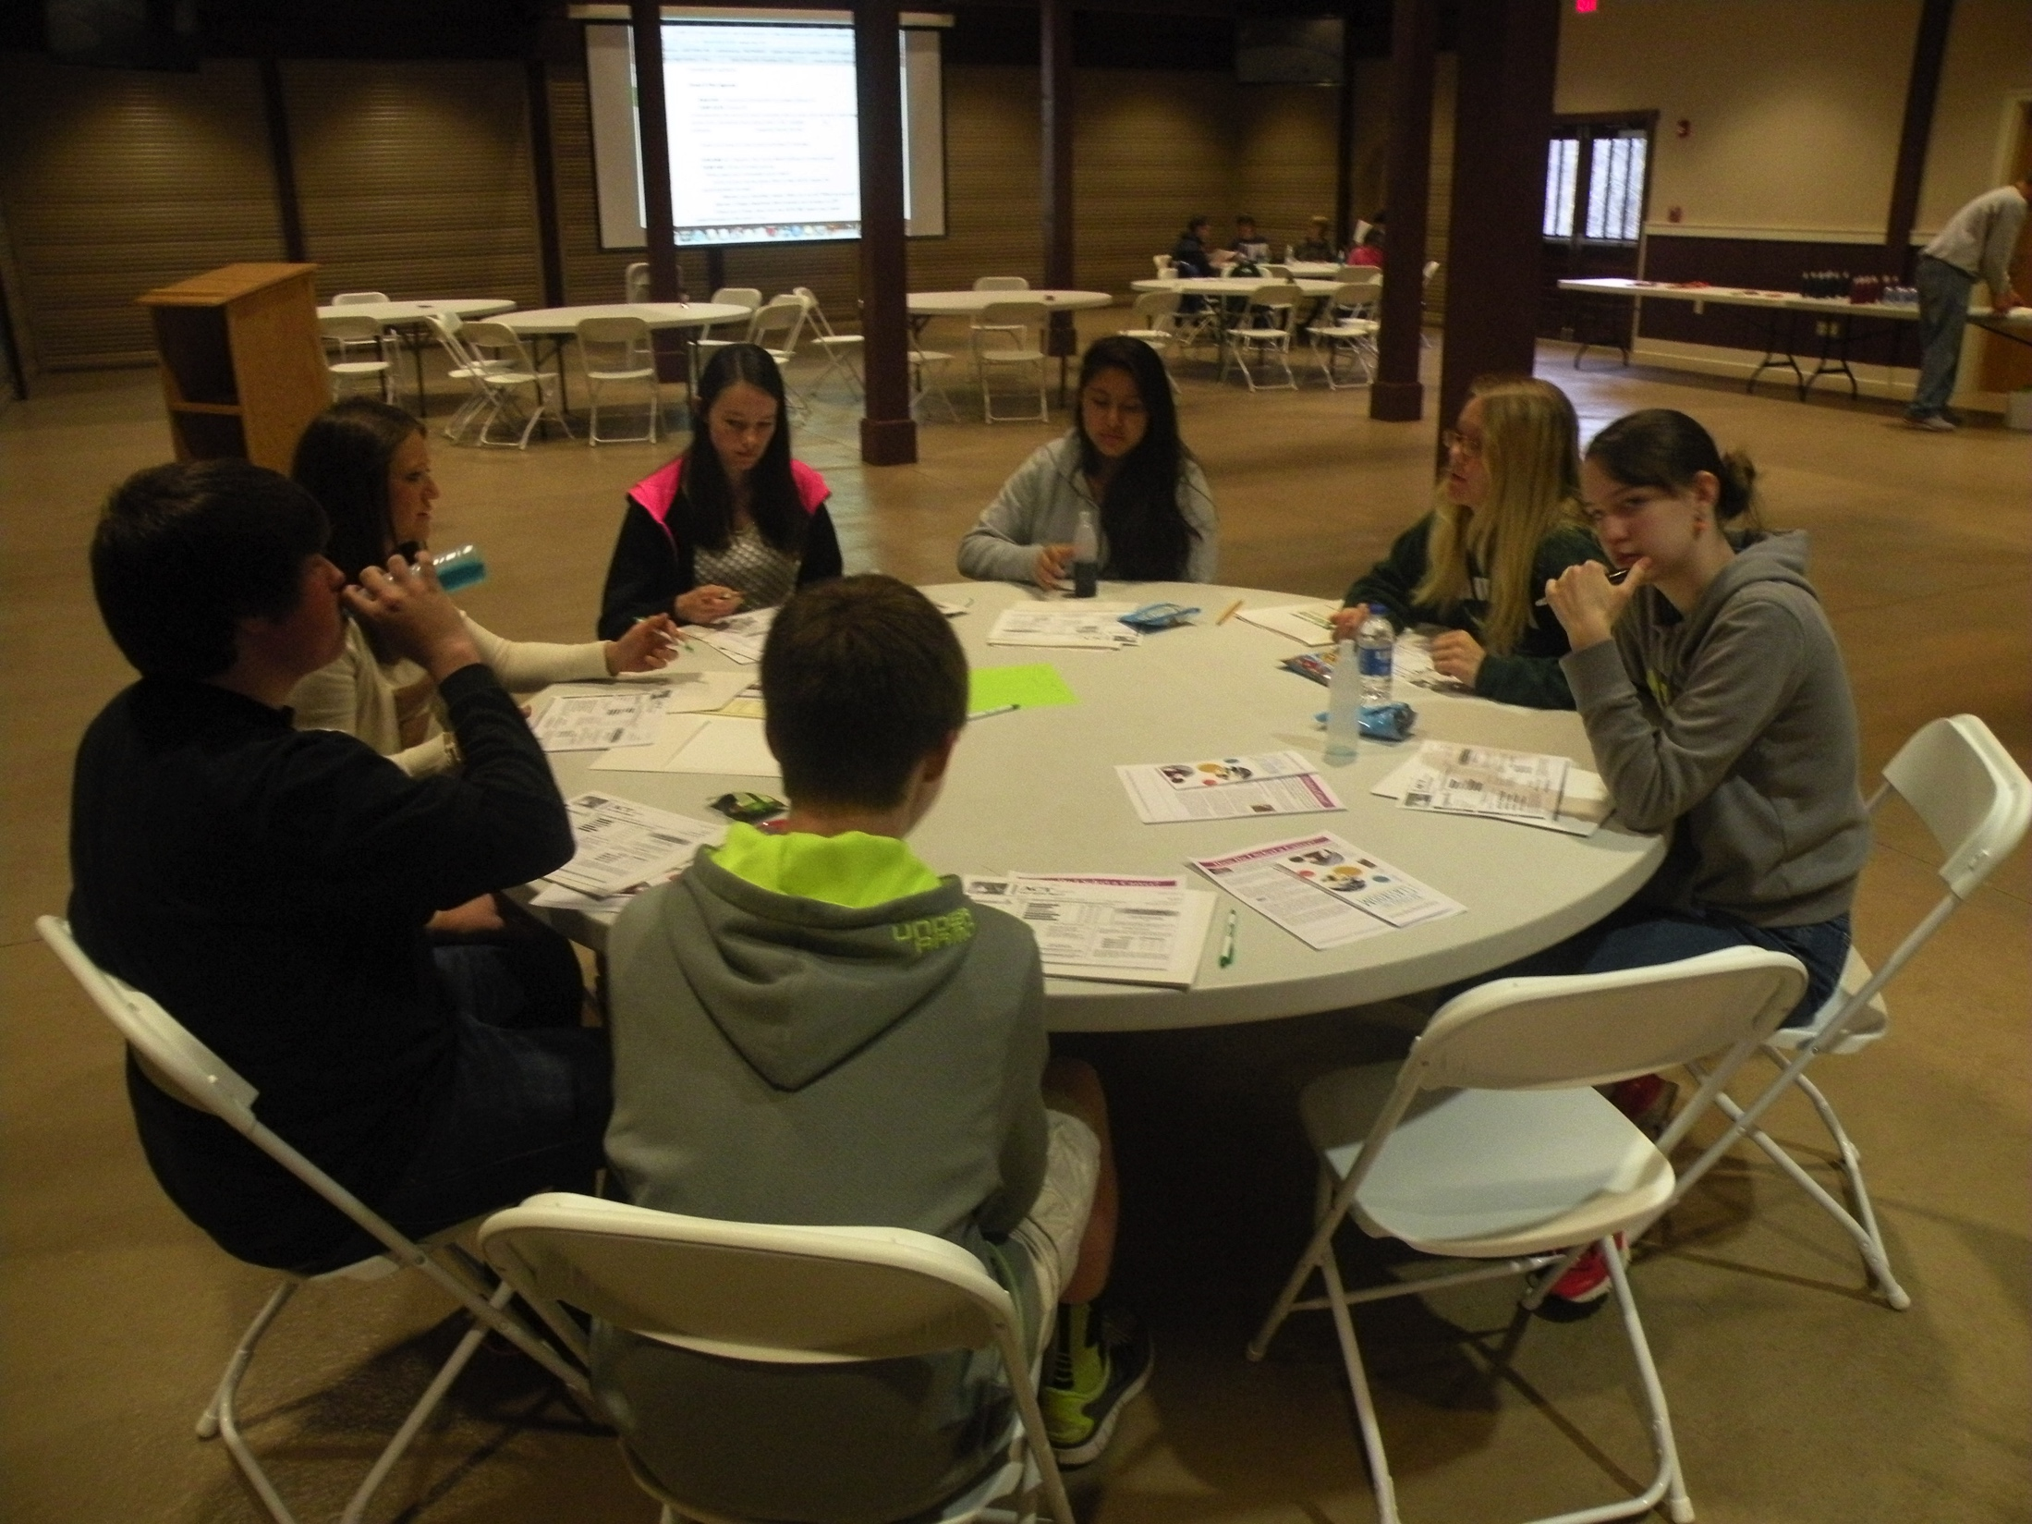
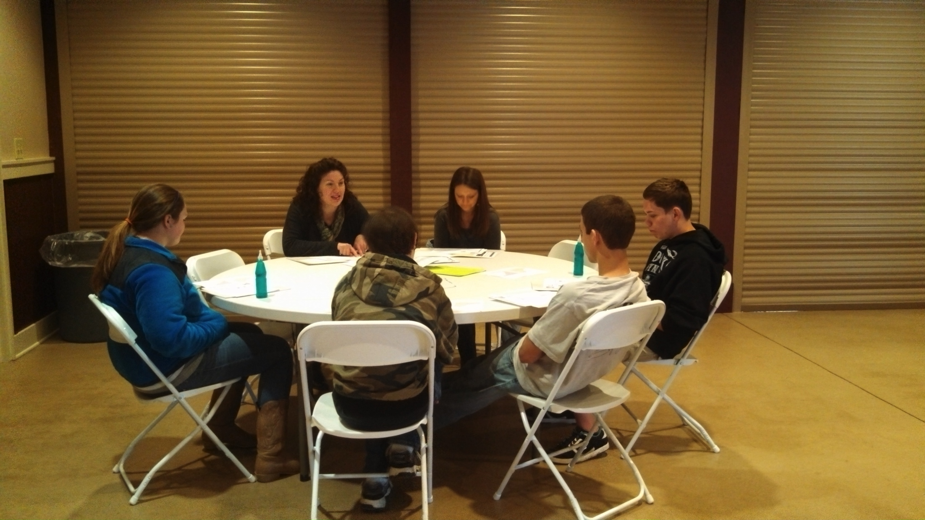
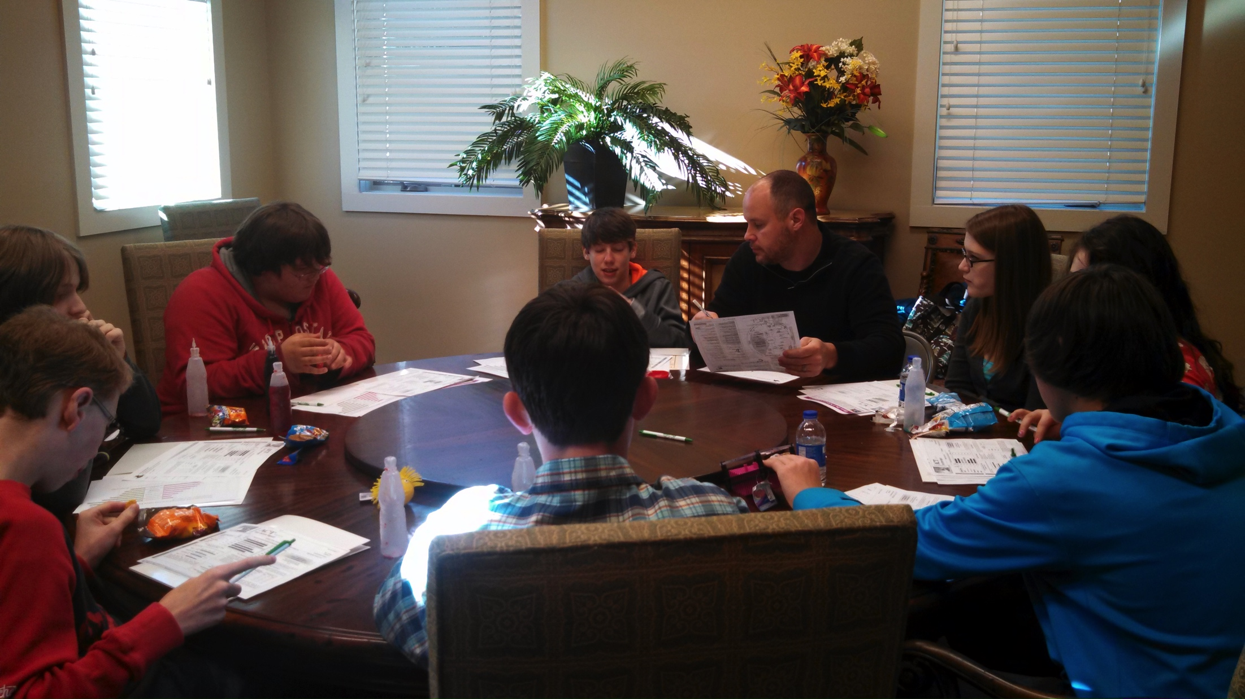
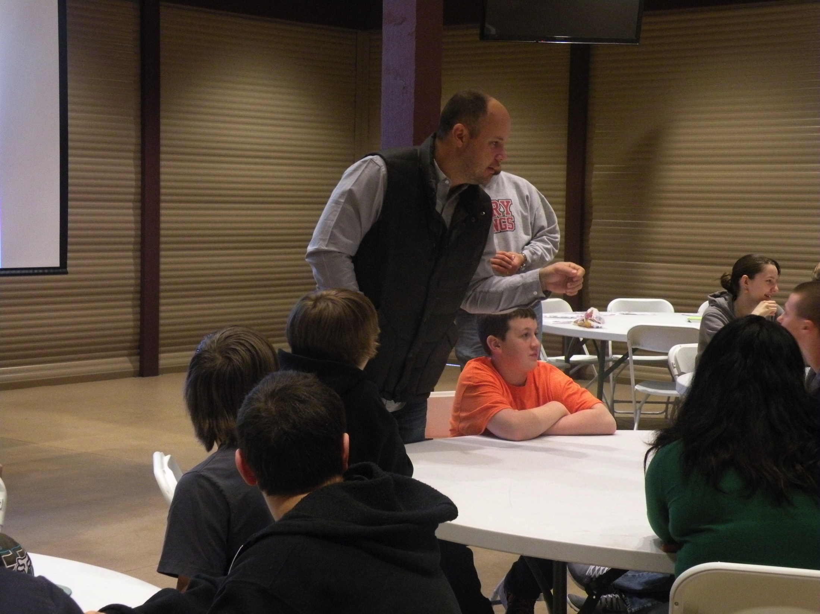
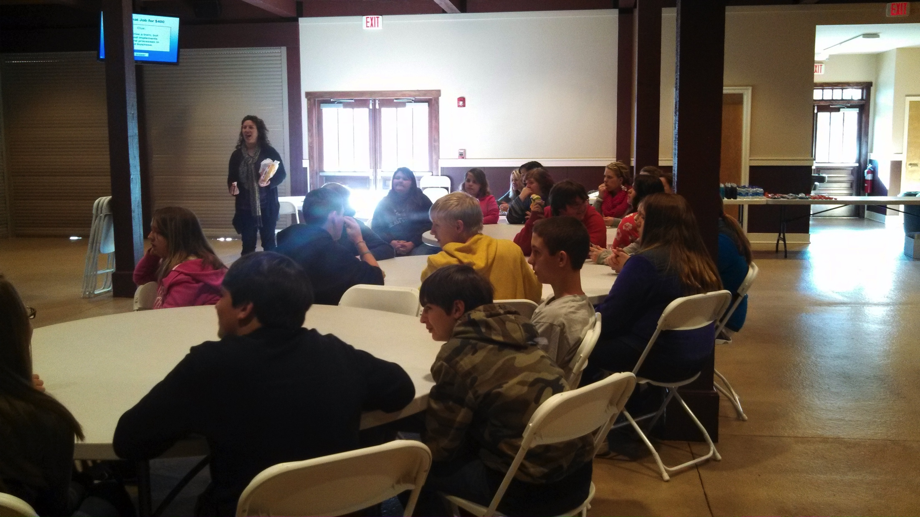
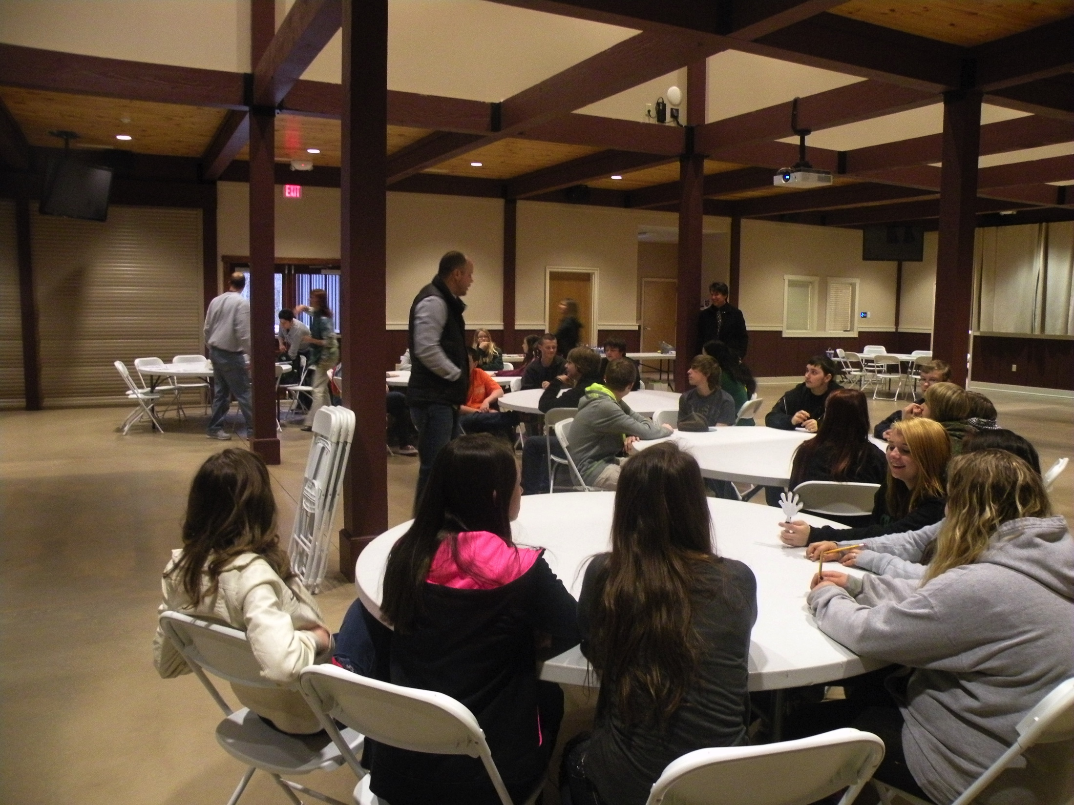
Students interact with school and workforce development counselors

Slide 7
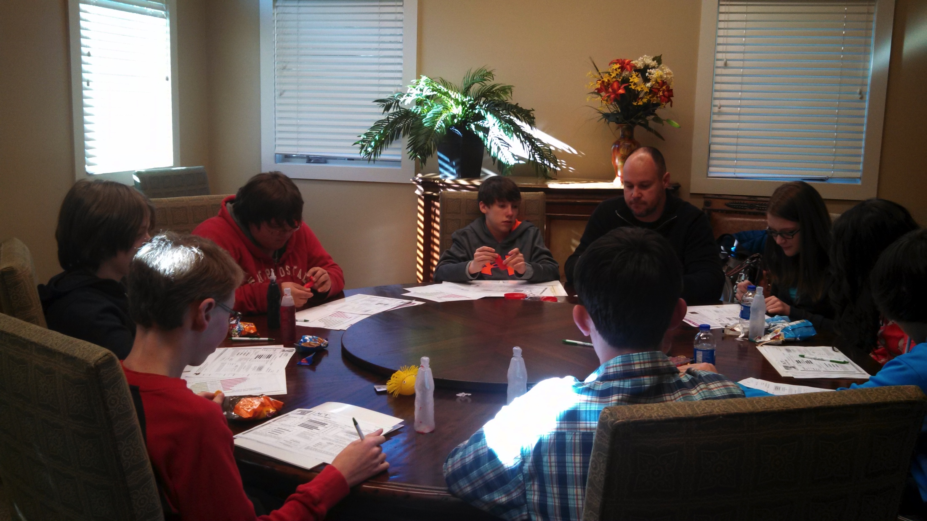
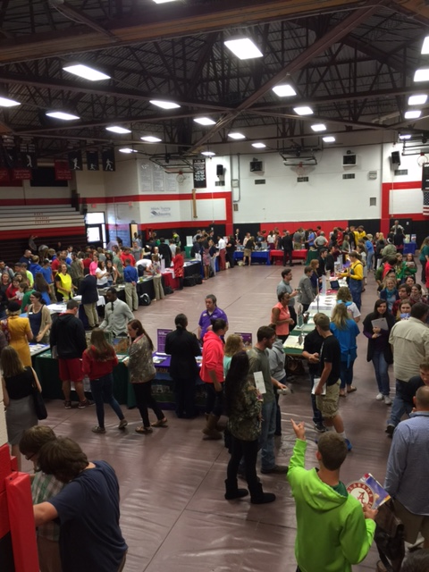
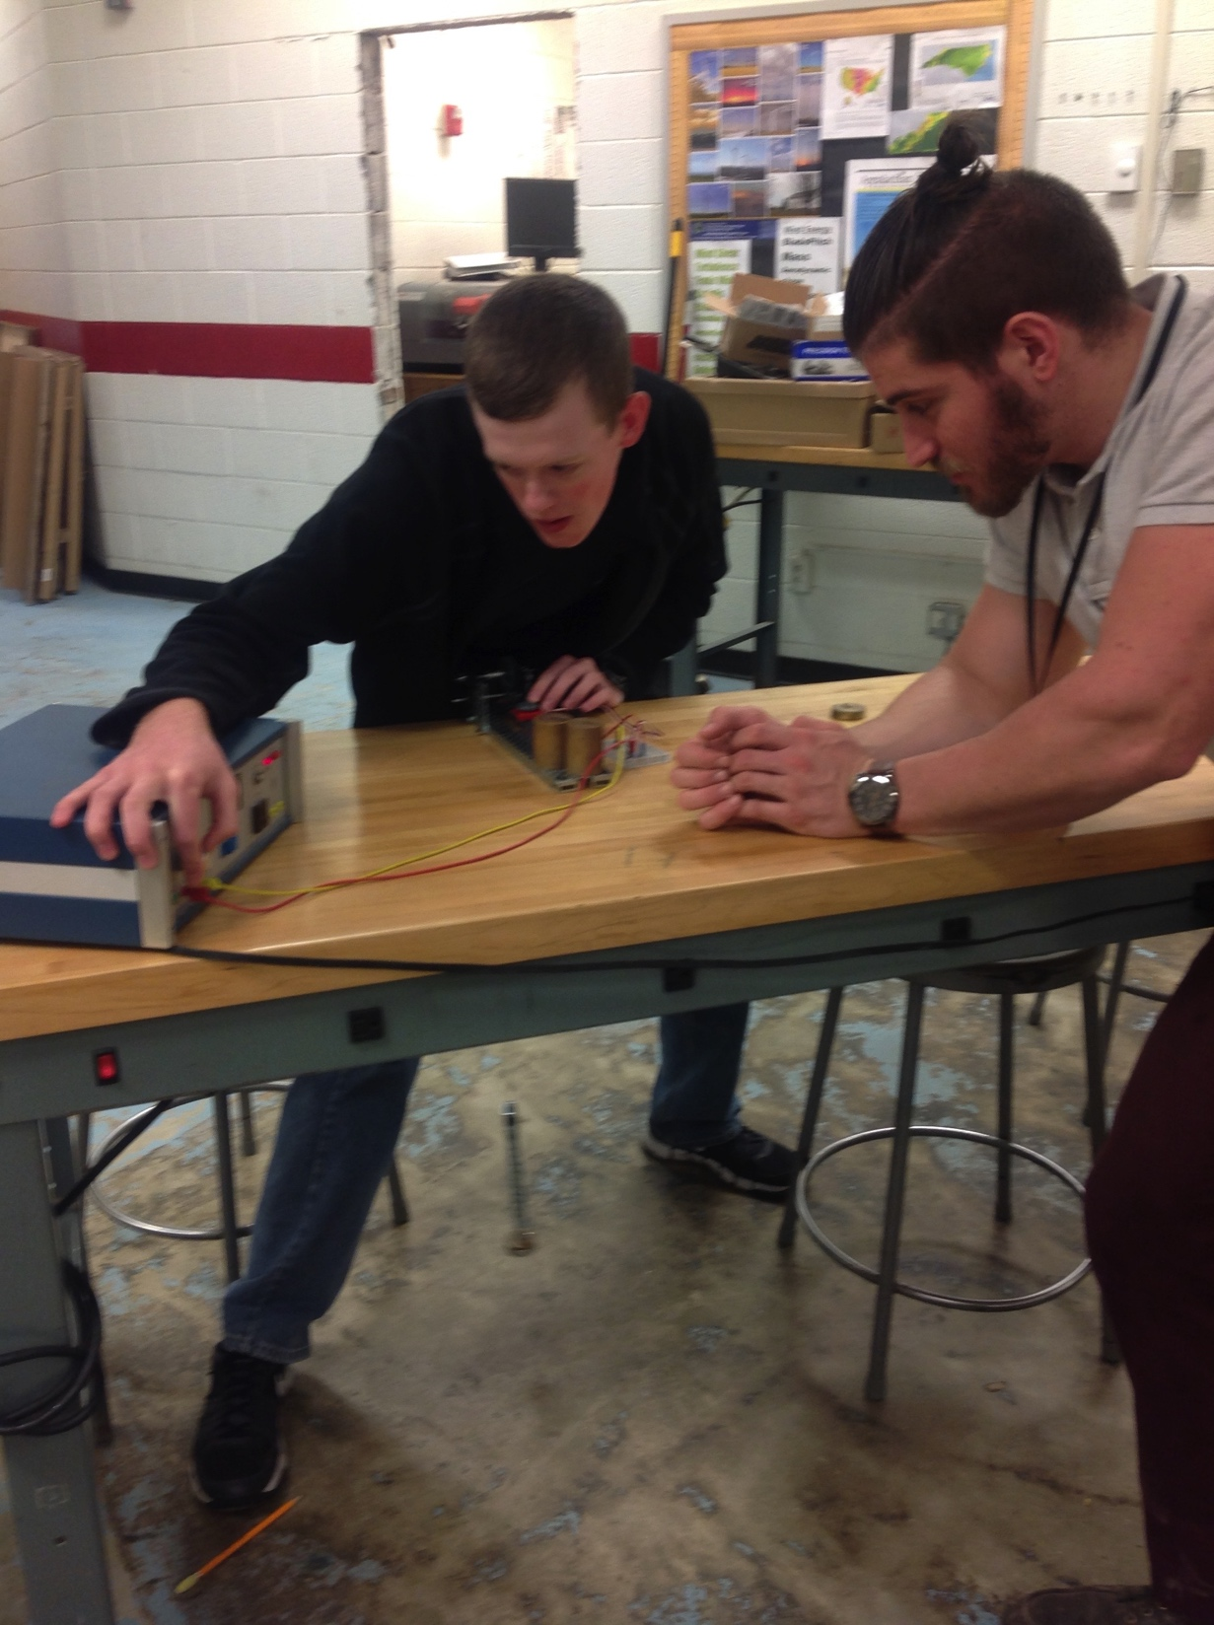
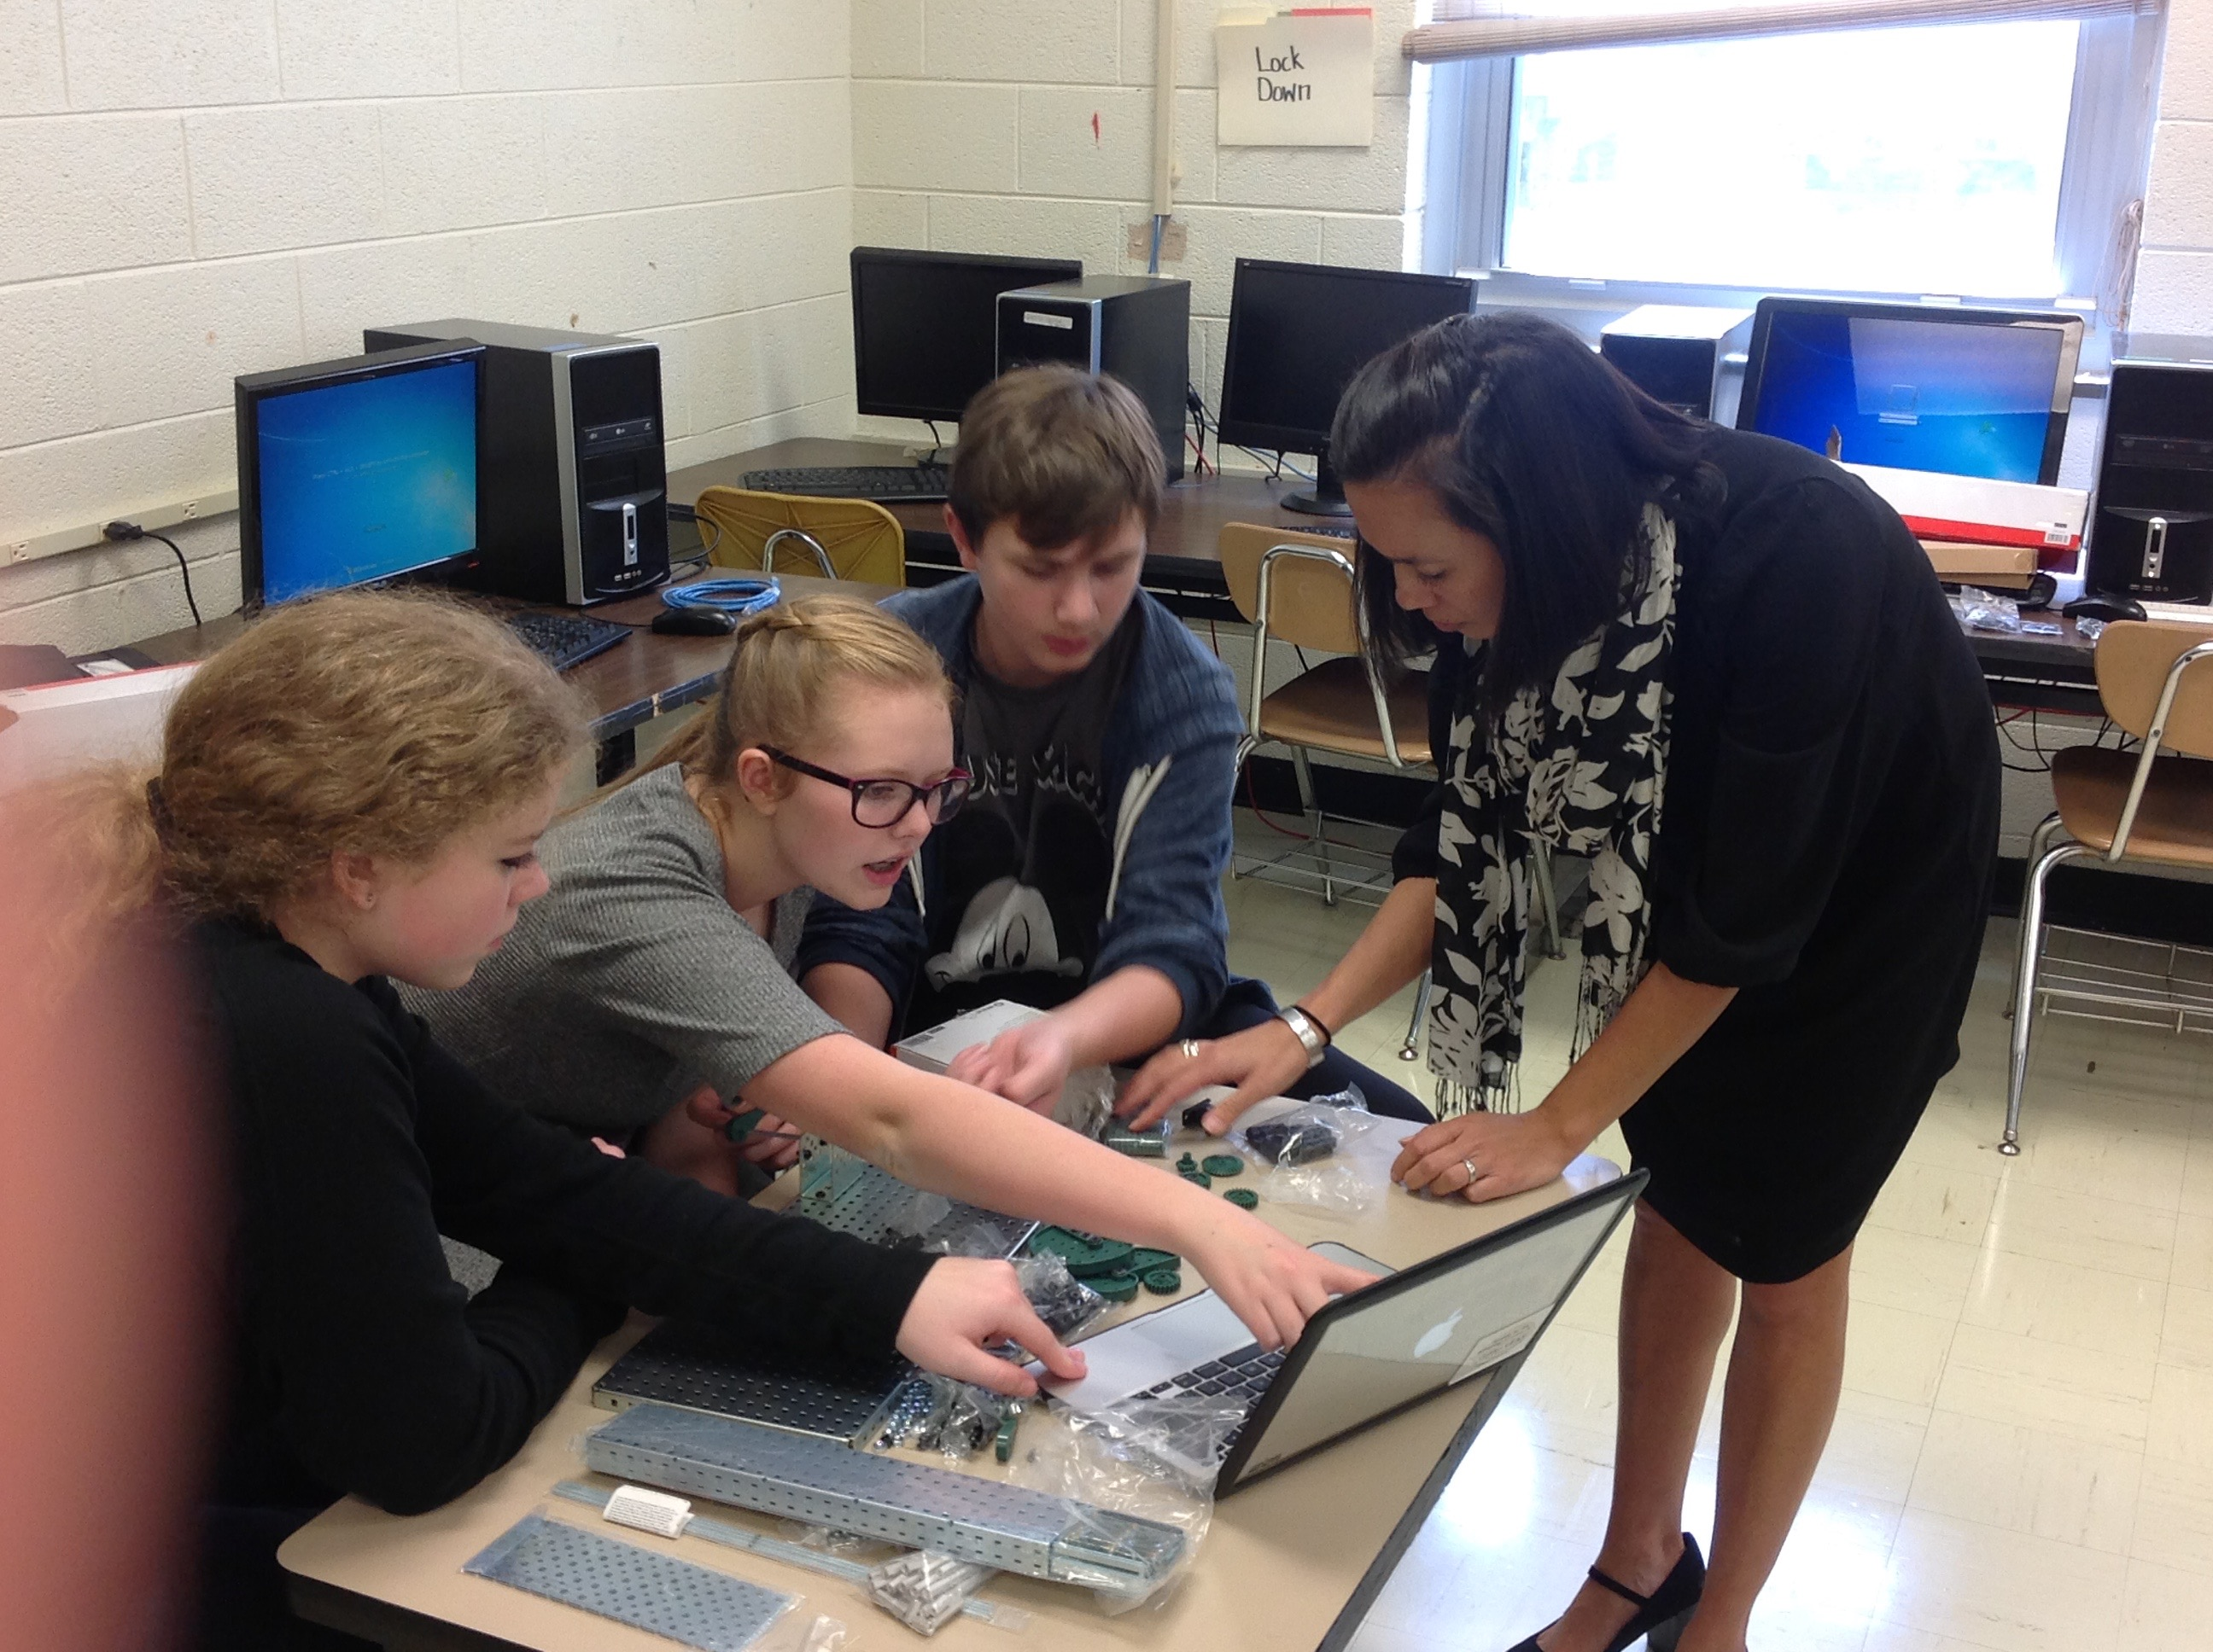
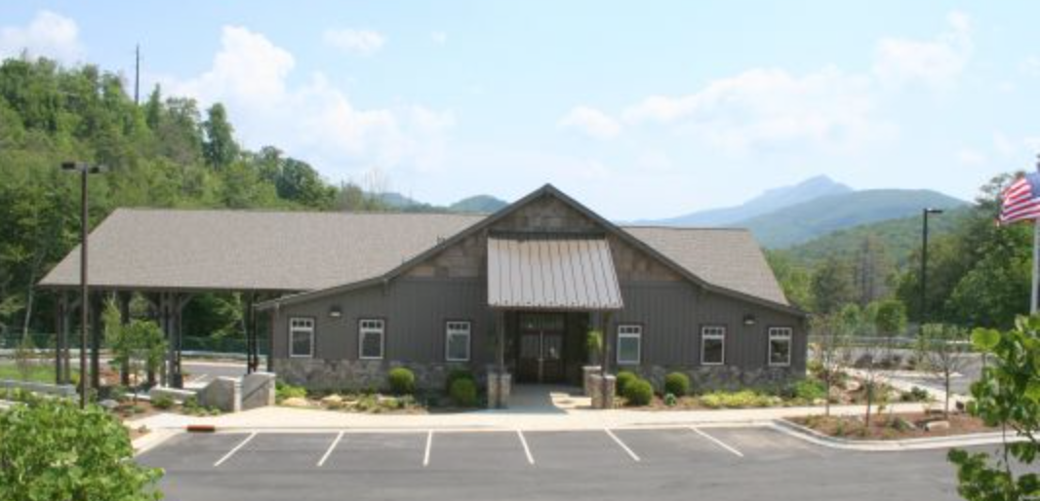
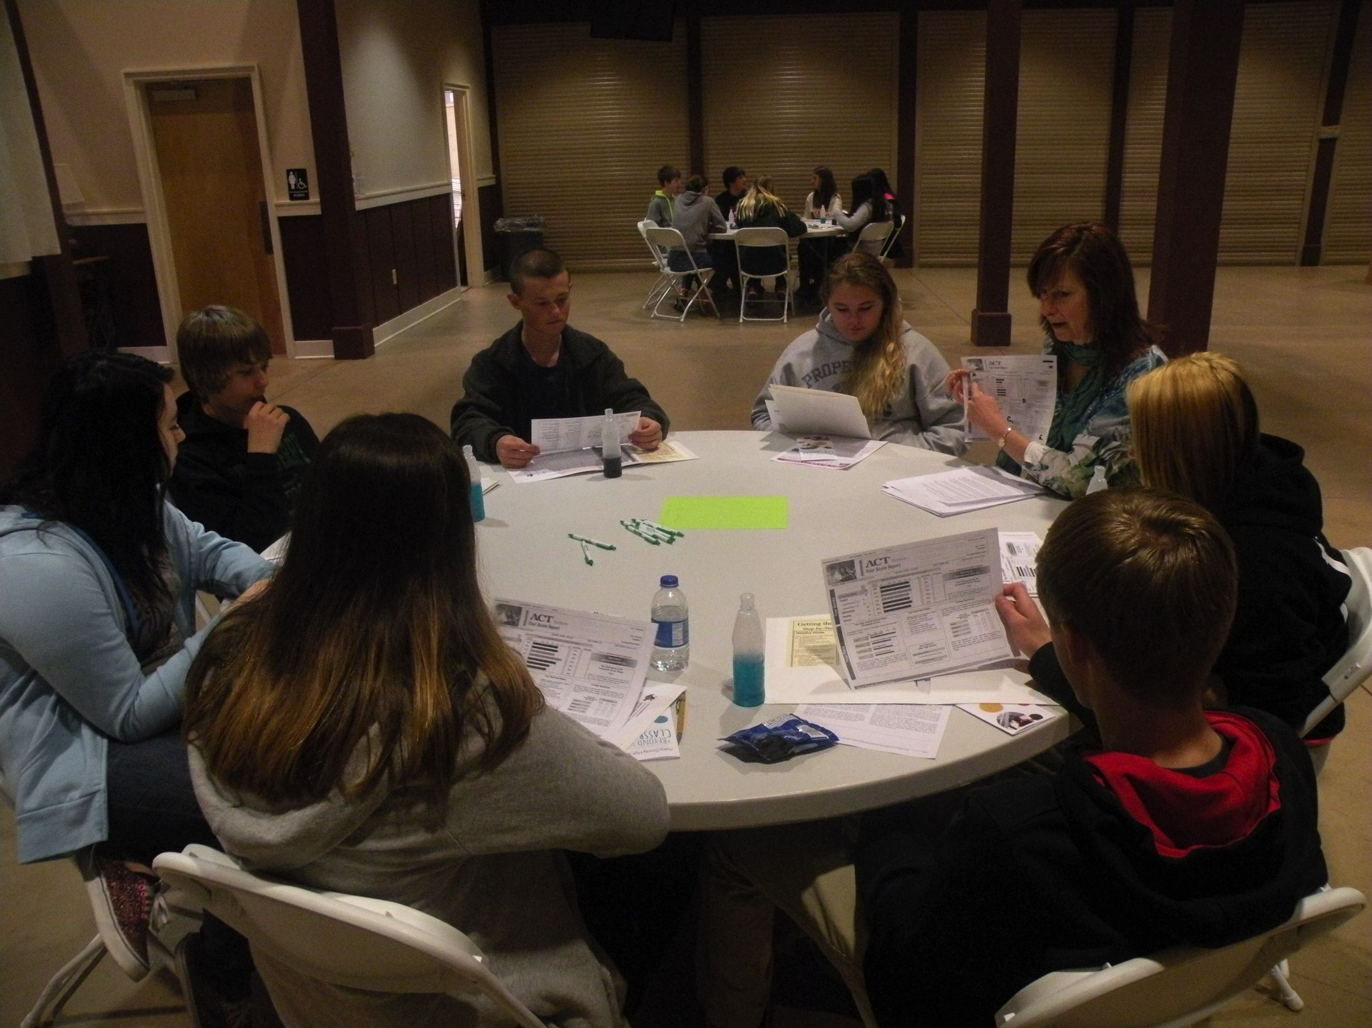
Achievements and Future Plans
Celebration and Parent Information Night
Parents, student and counselor register for 9th grade
Structured High School Visits after registration
On the job training experiences
Credentials and Career Pathways
Blue Ridge Academy
Prepared Workforce

