Slide 1
WELCOME!
Notes:
GEAR UP Powerpoint on basecamp make a copy on the computer call it blank powerpoint show coordinators how to add slides etc. Upload to basecamp

Slide 2





Under NACACHE
(NC Appalachian Collaborative for Higher Education)

Slide 3
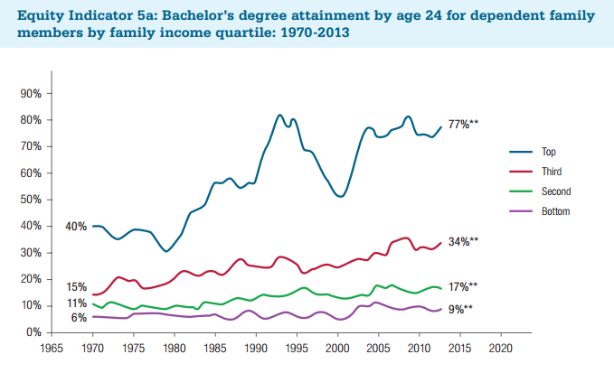

Slide 4
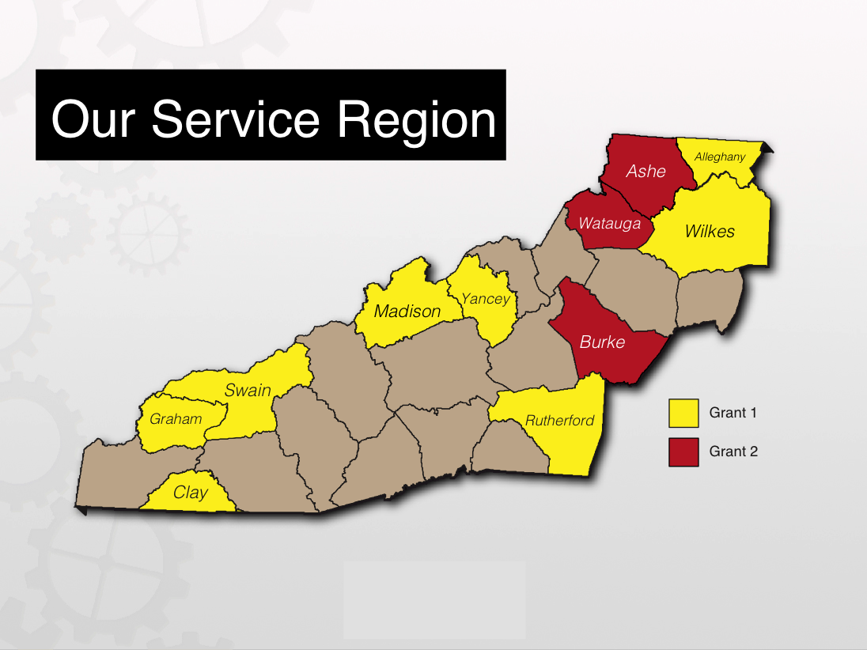

Slide 5
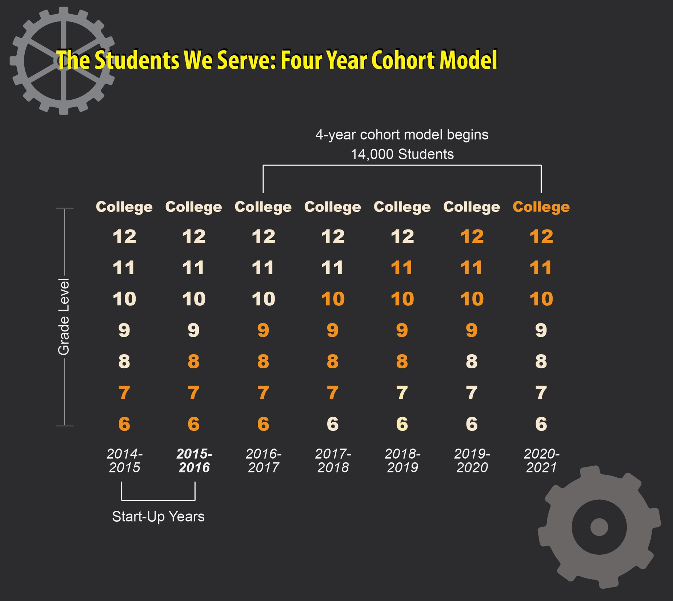

Slide 6
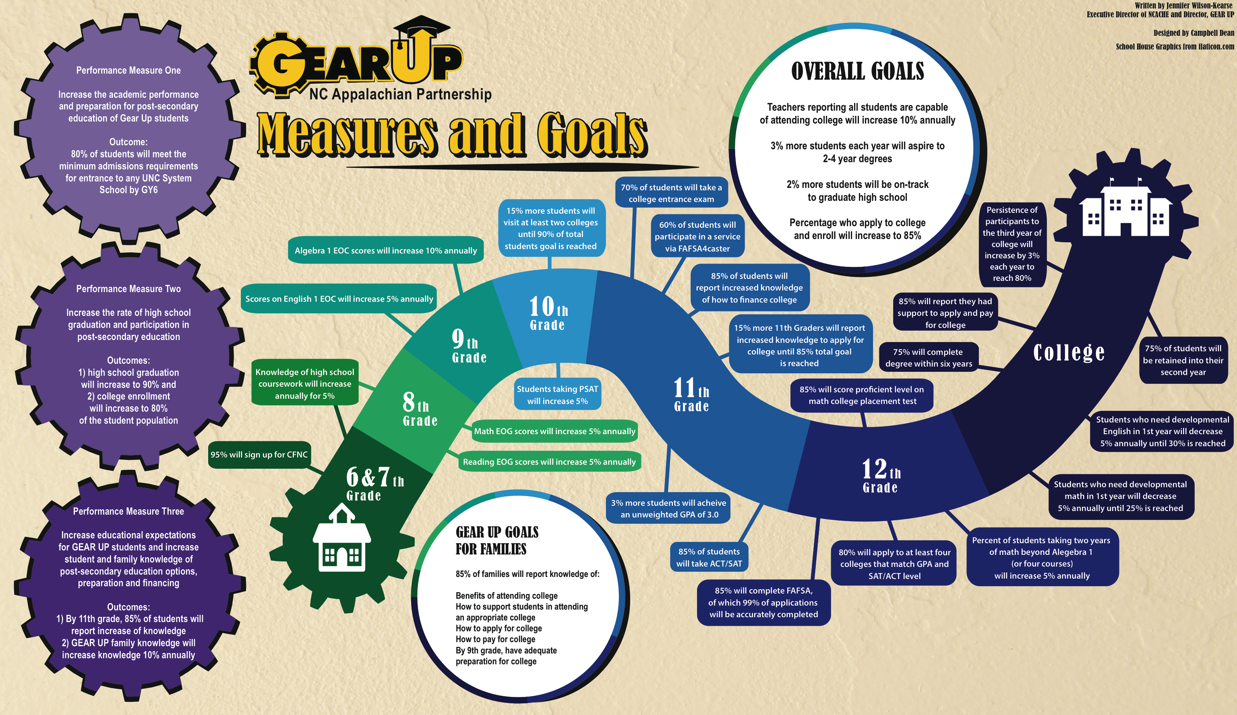
Timeline of GEAR UP Goals by Student Grade Level

Slide 7

Direct Programs for our Students
AsU Lead

Slide 8



Partnerships to Provide Direct
Resources and Services for our Students and Educators
Texting Platform

Slide 9
GEAR UP Year 2 Data Collection
Student Demographic Data
Student Academic Data
Student Absence Data
6th Grade Survey Data
Teacher Survey’s
ACT Engage
Student and Parent Services

Slide 10
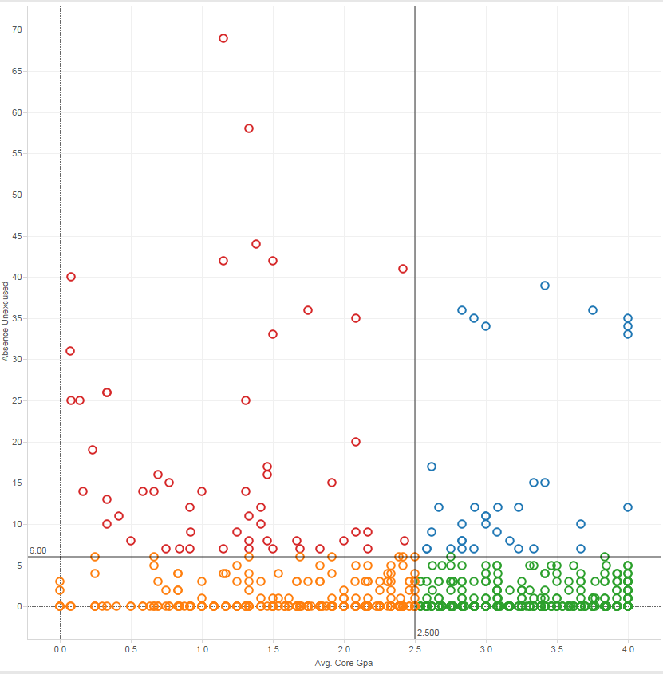
Absence & GPA example
Data shows a negative correlation between number of absences and Average Core GPA
As a result we can divide the students into quadrants in order to identify specified services/programs to reduce truancy and improve GPA via mentoring/tutoring services
Our specialized database also allows us to breakdown by county and school district to focus on individual students (next slide)
Our Absence/GPA data allows us to develop risk assessments for academic achievement in math and reading

Slide 11
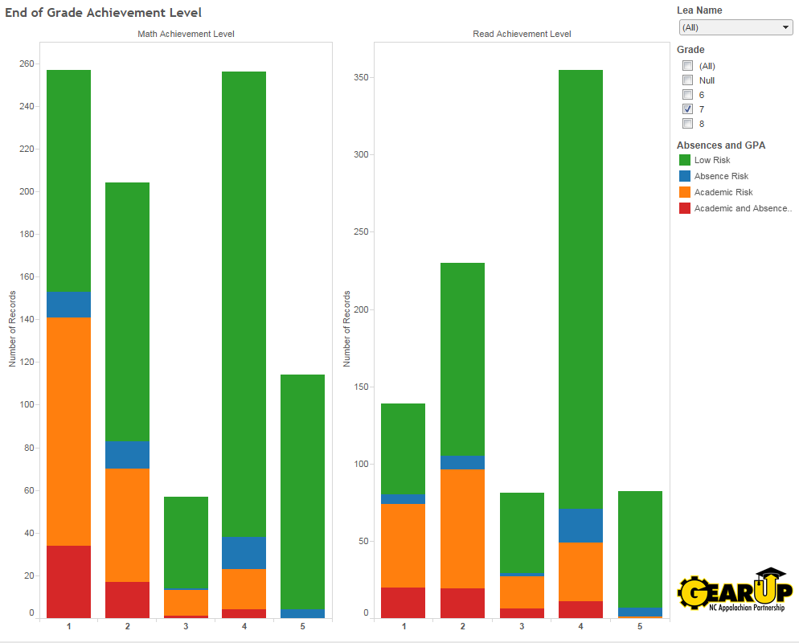

Slide 12
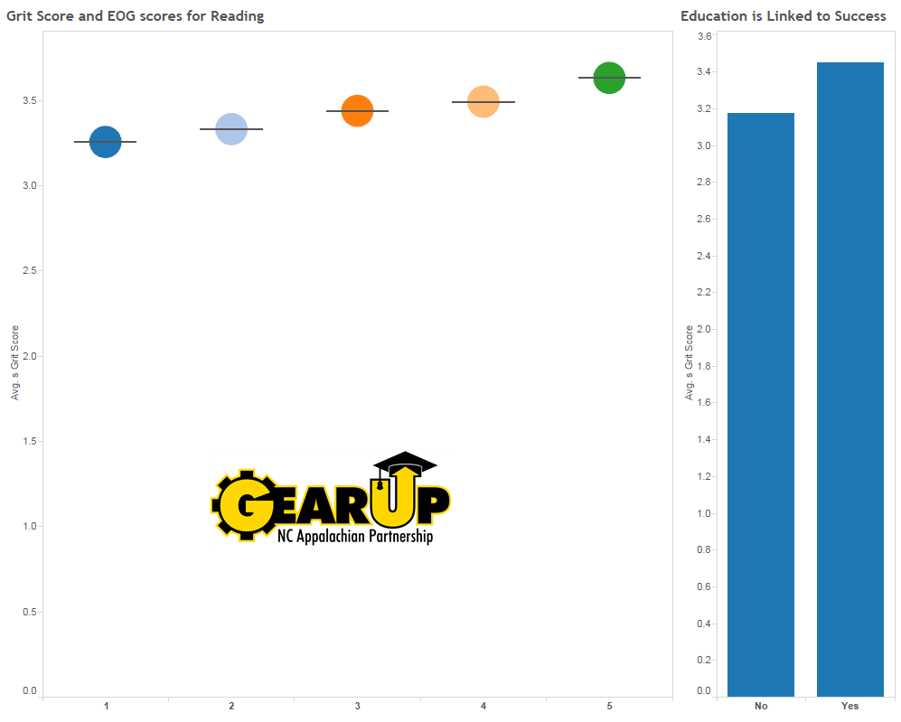
Grit Scale
GRIT Scale responses show a positive correlation between student GRIT and academic success
GRIT is not meant to be a longitudinal goal, but rather an important indicator in the here-and-now on how to respond to student need
  i.e. students with a low GRIT score are considered to be in academic risk in statistically appropriate areas

Slide 13
Entrepreneurship Questions
Taken from the Gallup-HOPE Index
48% of GEAR UP students envisioned starting their own business
  42% for the United States
51% had someone in their family who owned a business
  32% for the United States
56% indicated that they “like to invent things”
  38% for the United States

